Slide 1
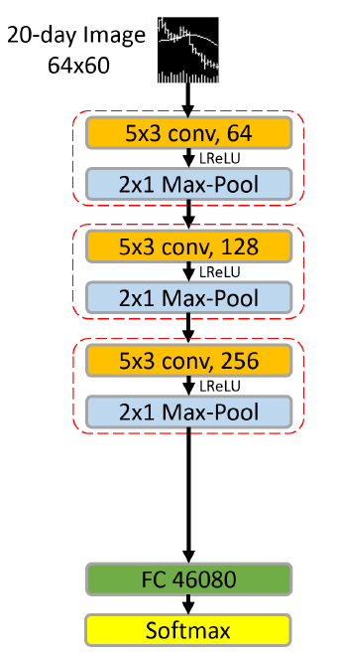
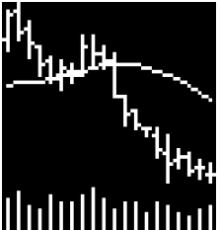
MAFS6010Z Mini-Project 2: (Re-)Imag(in)ing Price Trends
Ziyi WANG(20256265)¹ and Jixiang XIANG(20568852)¹ {zwangbn, jxiangae}@connect.ust.hk
¹: Department of Mathematics, HKUST
1. Introduction
3. CNN Architecture
5. Model Tuning and Result
Based on the paper of re-imaging price trend, we try to predict the trend of stock based on the imagines provided by tutor. The main idea is that by leveraging CNN model, the trend signals can be detected and provide the investors portable investing advices.
Following the architecture designed in the paper, there are 3 CNN building blocks and 1 Fully Connected layer.
For 1st CNNN block, there are 3 components:
Conv2d with kernel being (5,3), stride being (2,1), and dilution being (2,1)
Leaky relu layer with negative slope being 0.01
Maxpool2d layer with kernel being (2,1)
For 2nd and 3rd layers, we used the similar CNN blocks with the 1st layer. The only difference between those two types of blocks is:
Dilution being (1,1)
After 3 blocks of CNN, all parameters are connected by using one fully connected layer with the number of out_feature being 3, which is the number of classes contained in column ‘Retx_20d_label‘.
The last layer of the whole neural network is softmax layer.
We tried to removed the soft max layer, because the input data dimension is already 64, if we use too much soft max layer, the information will be lost. After removing the soft max layer, both training, testing and validation accuracy increased, and entropy significantly decreased
We also removed the dilution in the 2nd layer for similar reason. A slight increase in accuracy and drop in entropy can be seen
RMS Prop uses uses a moving average of squared gradients to prevent the model going too far to the wrong direction. We can see that after using this, the training accuracy decreased but testing entropy decreased. Meaning it helped reduce the overfitting of the training stage
Adam combines the advantages of Momentum and RMS Prop, using a smoothed gradient instead of the initial gradient. You can see that after using Adam, both the accuracy of training and testing increased, and it reached the lowest entropy for the validation set.
In conclusion, Adam has been the best model for this project, and removing too much processing layers such as Soft Max Dilution will help to retain useful information from the data.
2. Data
Data Overview
The sample runs from 1993-2019 shows daily opening, high, low prices. Each imagine in sample shows the trend in 20-day.
The resolution of all images is 64*60 with moving average lines(MA:51) and volume bars(VB:12).
The column named Retx_20d_label is used as the label of our classification model, in which 1 for positive returns and 0 for nonpositive returns.
4. Loss Function and Optimizer
Because there are 3 labels in column named ‘Retx_20d_label ’, one of which is 2 to represent nan value, we set the weights of loss function being [1,1,0.1], trying to balance the imbalanced distribution.
The loss function used to measure the accuracy of current epoch is cross entropy loss with weight described above.
The optimizer tried in our experiment is SGD. The learning rate is 0.0001 and the momentum is 0.9.
We also tried different optimizers, including RMSProp and Adam. The result will be compared in the next section
Model Tuning Changes | Model Performance
 | Training Accuracy | Training Cross Entropy | Testing Accuracy | Testing Cross Entropy | Out of Time Accuracy | Out of Time Cross Entropy
Base Model | 0.51 | 1.2181 | 0.51 | 0.9622 | 0.51 | 1.0451
Removed Soft Max Layer | 0.62 | 0.6247 | 0.52 | 0.6905 | 0.51 | 0.7121
Remove the dilution in 2nd layer | 0.61 | 0.5415 | 0.52 | 0.6657 | 0.5 | 0.7089
Changed the optimizer to RMSprop | 0.54 | 0.6425 | 0.52 | 0.6955 | 0.51 | 0.7113
Changed the optimizer to Adam | 0.55 | 0.6764 | 0.52 | 0.6881 | 0.51 | 0.7013
6. Contribution
Base Model: XIANG Jixiang
Tuning Model & GPU Set up: Ziyi WANG

